Slide 1
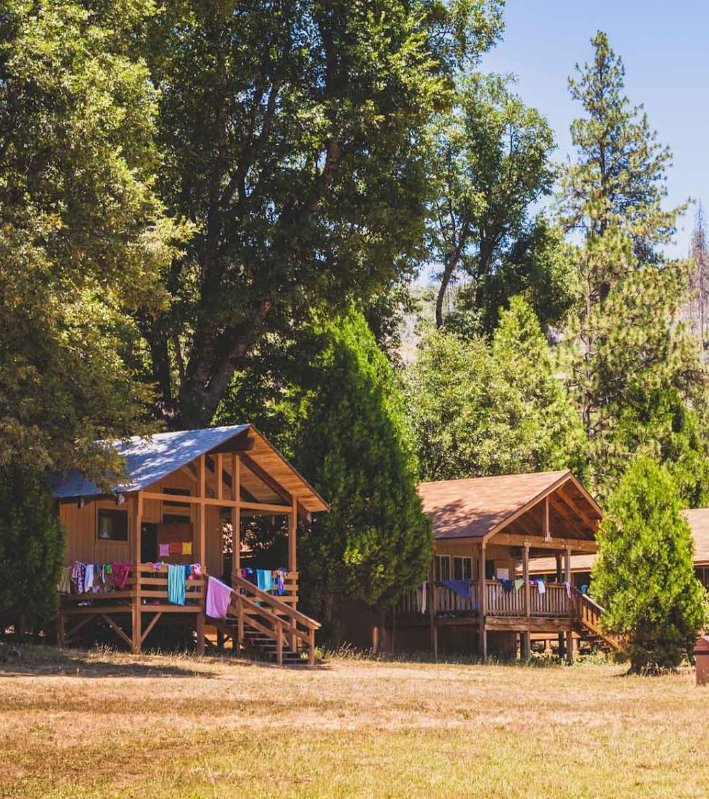
Summer Camp Database
CCPS510
Final Presentation
Johnathan Spinelli - jspinelli
Rui Zhang - rui2.zhang

Slide 2
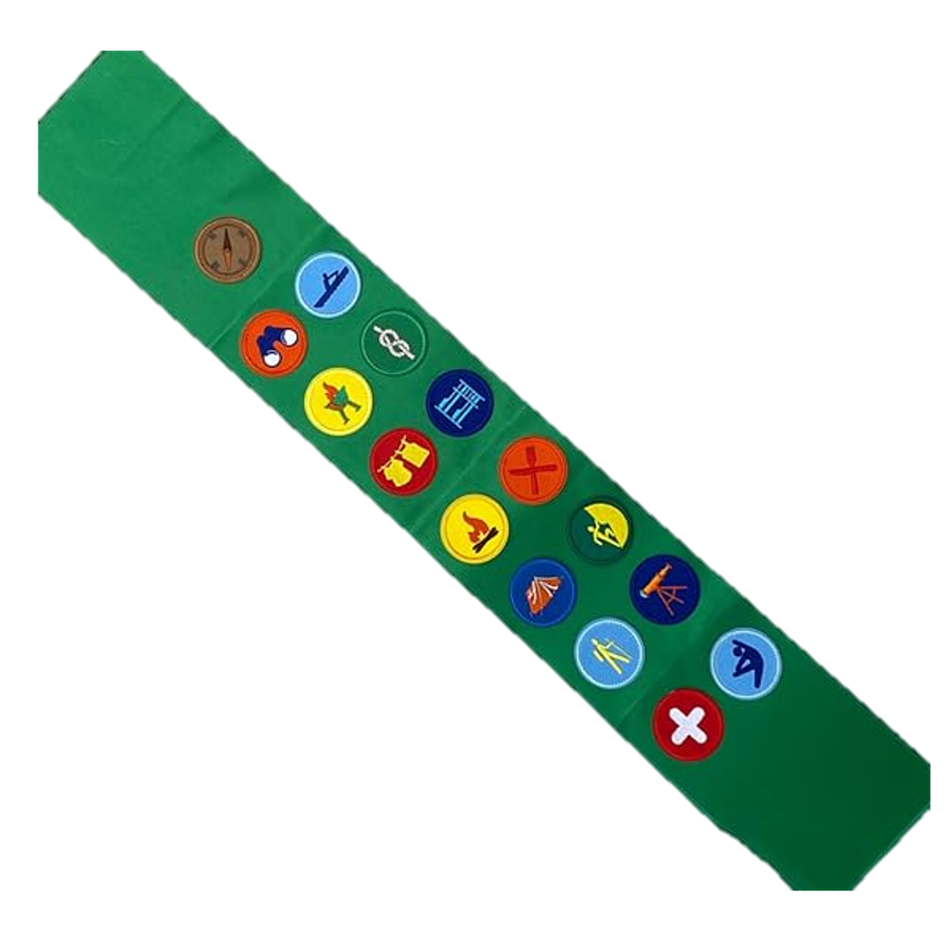
Topic Overview
Children attend summer camps to spend time outdoors, develop new skills and make new friends
These summer camps often have a lot of planning in order to make things run smoothly, as there is a lot of responsibility placed on the coordinators watching over a large group of children in the wilderness.
Activities for campers to sign up for, allowing them to customize their own camp experience
Parents/Guardians may want to check in on their children throughout the week
Campers earn badges for learning or displaying a skill during an activity, such as fire starting
The database solution will provide structure to the camp organizers, allowing for recording participant information and planning events held throughout the duration of the camp.
Notes:
J

Slide 3

Database Solution
Database will contain records for each of the campers and counsellors
Activity table containing a list of all possible activities that can take place at the camp
hiking, kayaking, soccer, etc.
Event table contains the scheduling for where and when the activity will take place, which counsellor is leading the event
Parents will be able to sign their campers up for events in advance
Activities may have an associated badge for campers to earn
Parents can track their child’s progress through their badge collection table
Parents would use a website to manage their child’s camp experience
Admin staff have full access to database, planning activities and events
Counsellors can see registration for their events and emergency contact info for campers
Application to update a camper’s badge collection based on completed events
Notes:
J

Slide 4

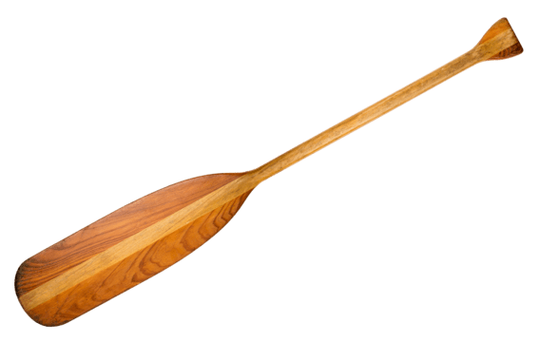
Business Rules
Counsellors have exactly one address, and campers have exactly one address, but an address may belong to many counsellors and/or campers. An address cannot exist without an associated counsellor or camper
A camper has exactly one guardian, and a guardian can belong to multiple campers
Counsellors can lead many events, and each event has exactly one counsellor leading the event
An event has one corresponding activity, but an activity may be run for many events
Each event takes place at a campground location, and a location may be used for many different events
An activity may only have one badge associated with it, but a badge may be associated with many activities
A camper may earn many badges, and a badge may belong to many campers
It’s also possible that a rare badge exists that no campers have earned yet
A camper can register for many events, and each event can have many campers registered (N:N)
An activity may have many equipment items, but each item belongs to a single activity
Notes:
R - Underlined rules are ones that we can emphasize. Last underlined one can lead us to talking about the N:N relationship, which can be broken down into a bridge table. Not mentioned here because that’s not a business rule

Slide 5
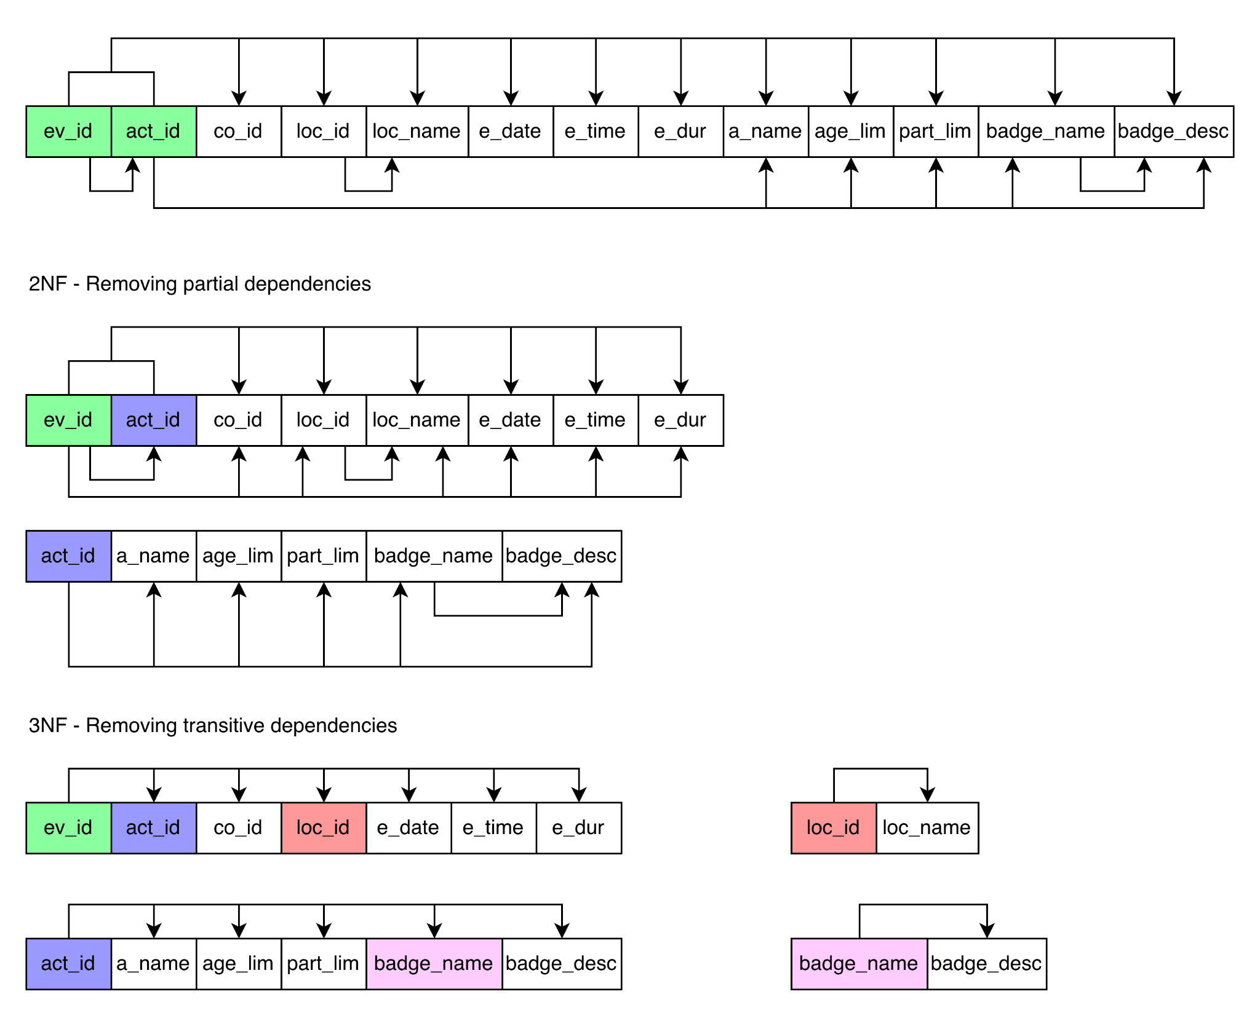
Normalization
A single event required a lot of information
Broken down into separate tables, which can be used for multiple different activities
Same activity can happen multiple times per week
Badges are easier to associate with activities and campers
Notes:
J

Slide 6

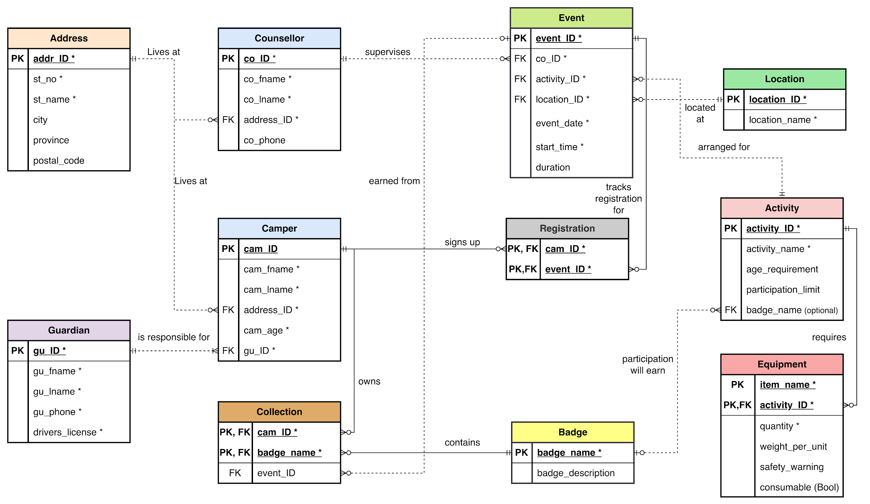
Notes:
R - Tables with a fire are the ones meeting the 5 attribute minimum requirement

Slide 7


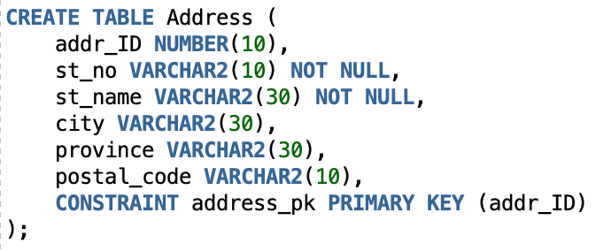
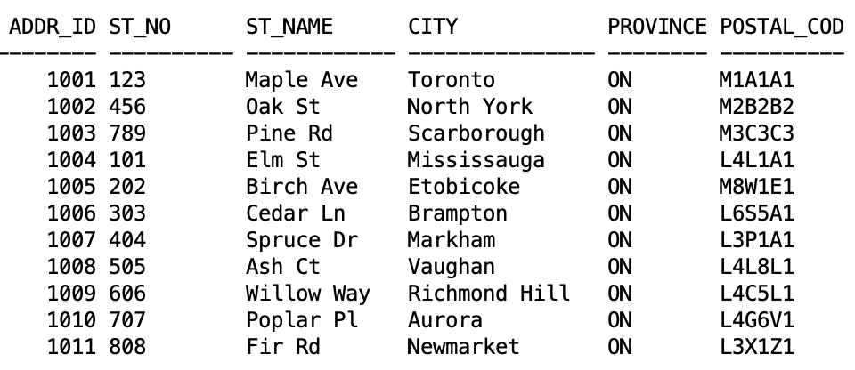

Sample Data - Addresses
Notes:
R

Slide 8
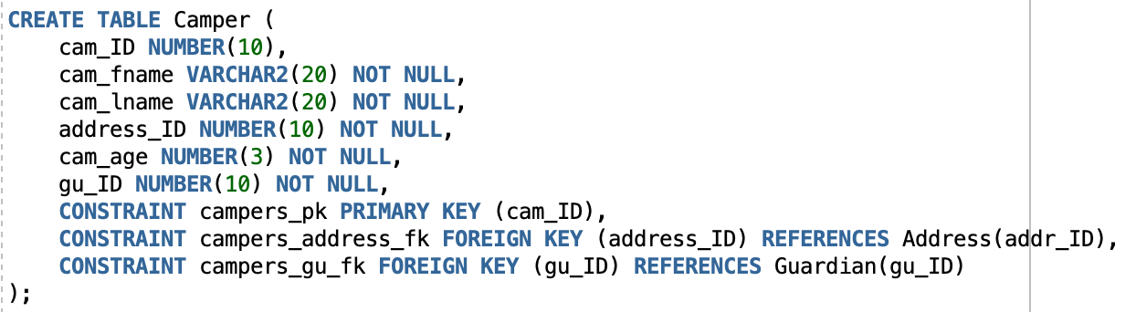
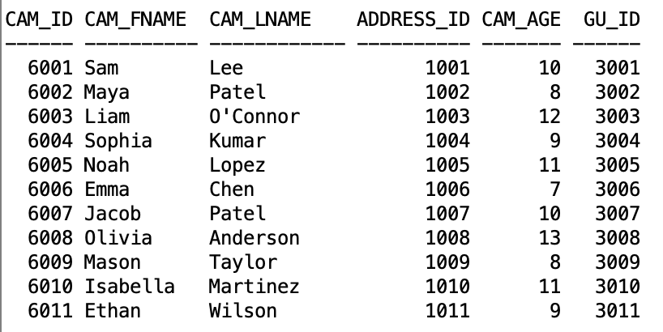

Sample Data - Campers
Notes:
R

Slide 9
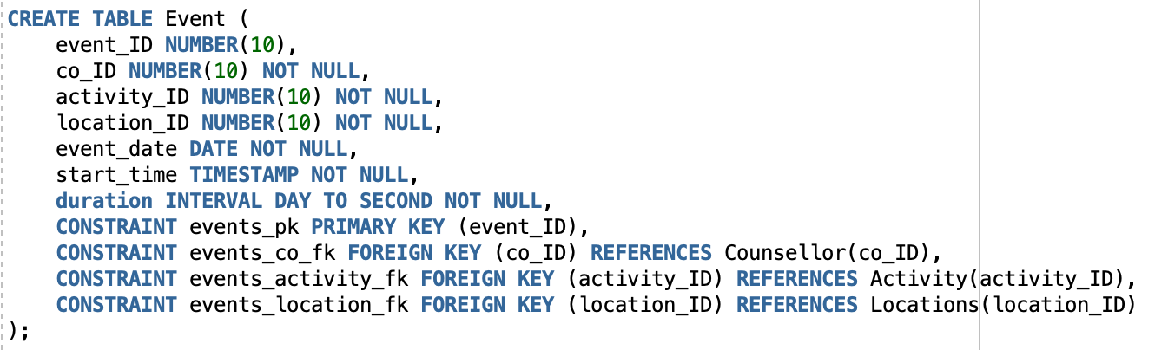
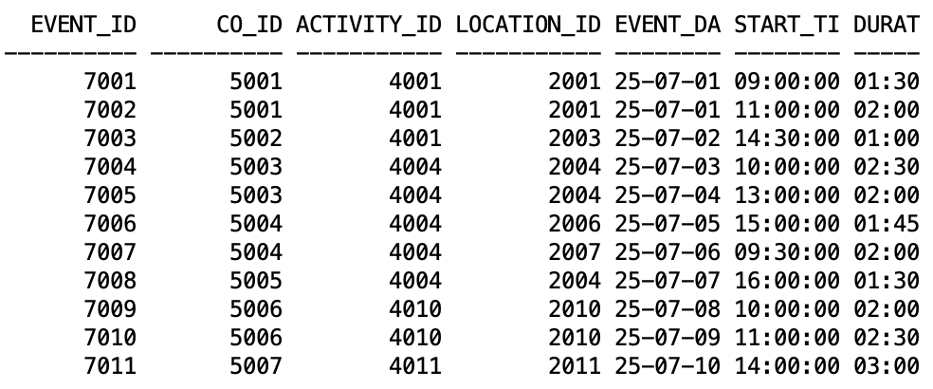

Sample Data - Events
Notes:
R

Slide 10
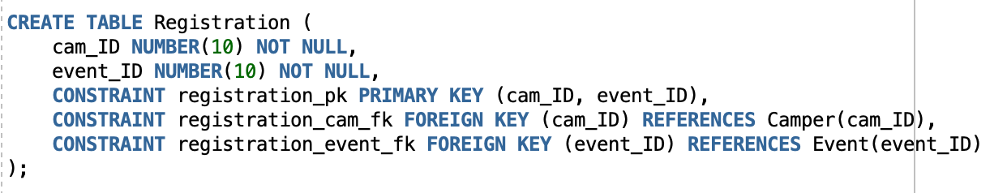
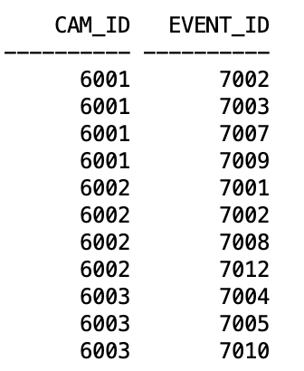

Sample Data - Registration
Notes:
R

Slide 11
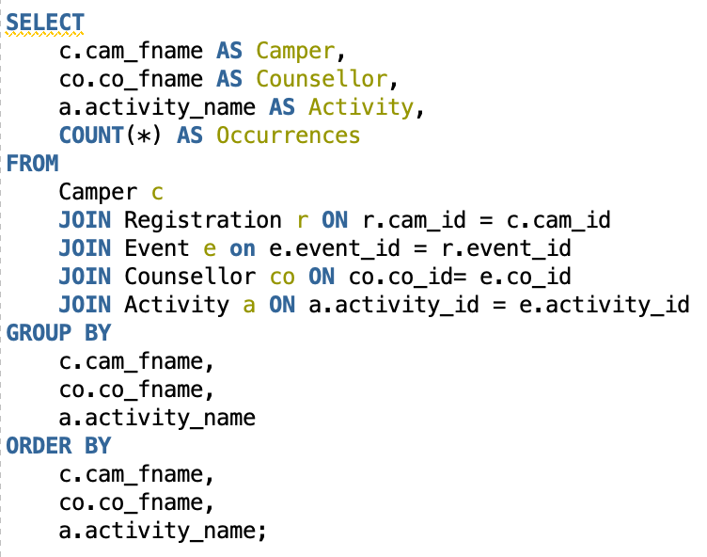
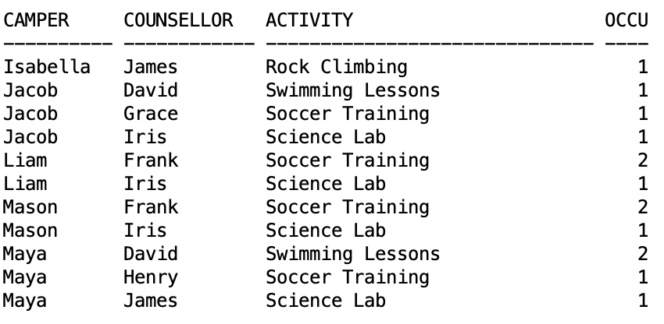
Sample Query - Camper & Counsellor
Admin staff put together a weekly “report card” for the campers, and they want input from each of the counsellors who spent time with them. Admin wants a list of how many times each camper did an activity with their counsellors.
Notes:
J

Slide 12
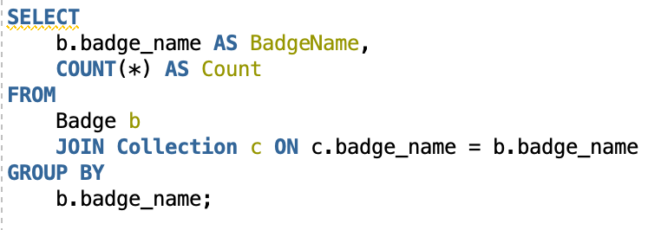
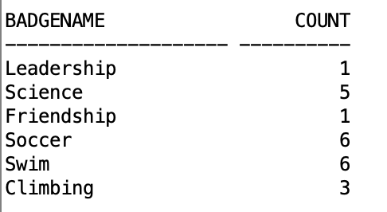
Sample Query - Badge Ceremony
At the end of the week, there is a ceremony where the counsellors hand out badges to the campers. The director needs to know how many of each badge to bring to the ceremony.
Notes:
J

Slide 13
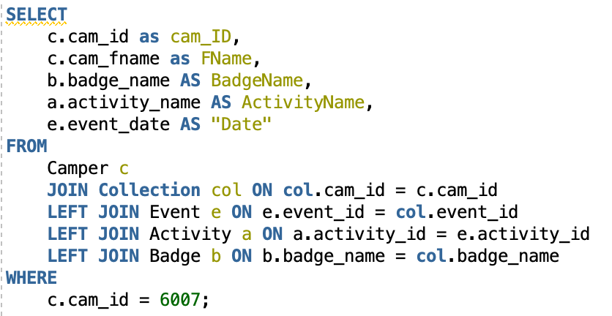
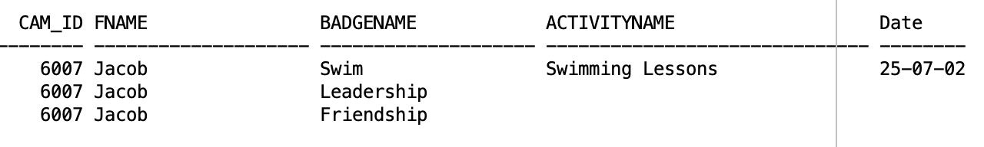
Sample Query - Badge Collection
Parents want to monitor their child’s progress throughout the week, seeing what badges they have earned and which activity it was earned through (if applicable).
Notes:
J

Slide 14
Other Potential Queries
Location availability - given a time range, check if a location is being used within that window
Assigned buddy - see which campers are registered for multiple activities throughout the week, counsellors can partner them up on the first day to make friends
Mailing list - houses with multiple children or both campers and counsellors don’t need to receive multiple pamphlets.
Activity refinement - activities with the least registrations may be phased out for next year
Notes:
R

Slide 15
Potential for Growth
Database design allows for future modifications or additions:
Allergy database
Counsellor certifications (First Aid, Lifeguard, etc.)
Identifiers for returning campers
Changes to the database would also require changes to the front-end for parents to interact with, counsellor registration, etc.
Notes:
J

Slide 16
Questions?

